Slide 1















Malicious URL Detection
Presented by -Harsh Lambe

Slide 2

Introduction
.
Malicious URLs pose a significant threat to internet users, leading to various cyberattacks such as phishing, malware distribution, and identity theft. Detecting these URLs accurately is crucial for ensuring user safety and maintaining cybersecurity.
This project aims to develop a robust system for identifying malicious URLs using Natural Language Processing (NLP) techniques in Python.

Slide 3
Evolving Cyber Threat Landscape:
The proliferation of cyber threats, including phishing attacks, malware distribution, and identity theft, highlights the need for proactive measures to combat malicious activities.
Need
And
Objectives
01.
Limitations of Existing Solutions:
Antivirus software and network security appliances often rely on known signatures or patterns to detect malicious URLs, making them susceptible to zero-day attacks and polymorphic malware.
02.
The project on malicious URL detection using Python and NLP is imperative due to the evolving cyber threat landscape and limitations of existing solutions. Traditional methods are often reactive and ineffective against new and polymorphic threats. Proactive detection is crucial for safeguarding user privacy, preventing financial losses, and maintaining organizational reputation.
Proactive detection of malicious URLs is essential for preventing cyber threats before they can cause harm.
03.

Slide 4
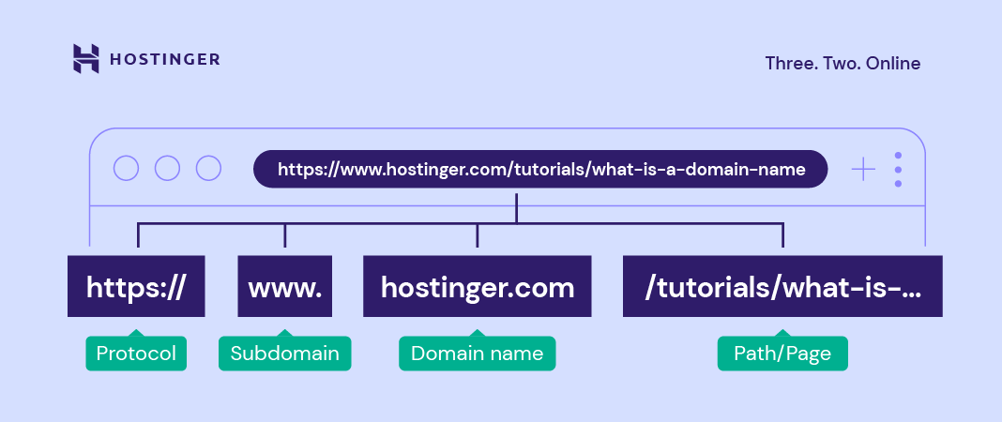
What is URL ?

Slide 5
Types of URL
Types of URL
01
02
03
04
Phishing URLs
URLs designed to deceive users into divulging sensitive information such as login credentials, financial details, or personal information.
Often mimic legitimate websites or services to trick users into believing they are interacting with a trusted entity.
Defacement URLs:
Defacement URLs refer to web addresses that lead to web pages that have been altered or vandalized by unauthorized individuals or groups.
These attacks involve modifying the content, appearance, or functionality of a website without the owner's permission.
Bengin URLs:
Benign URLs are web addresses that lead to safe and legitimate websites or resources on the internet. These URLs do not pose any security threat to users or their devices. Benign URLs are typically associated with reputable organizations, services, or content providers.
Malware Distribution URLs:
URLs hosting or distributing malicious software such as viruses, ransomware, or spyware.
Visiting these URLs can result in malware infections that compromise the security and integrity of the user's device or network.

Slide 6

Phishing URl
Malware URL
Phishing URL http://securelogin.bankofexample.com.loginattempts.co.uk/
This additional domain ("loginattempts.co.uk") is not related to the legitimate bank's domain and indicates that the URL is attempting to redirect users to a fraudulent website hosted on the "loginattempts.co.uk" domain.
shttp://example.com/download.php?file=malicious.exe
In the example above, the URL appears to lead to a file download page on a website hosted at "example.com."
However, upon closer inspection, the URL contains a parameter (file=malicious.exe) that specifies the name of the file to be downloaded.
Defacement URL
Defacement URL
http://www.example.com/defaced_page.html
In this example, "www.example.com" is the domain, and "defaced_page.html" is the specific webpage that has been altered without authorization. This URL would lead to a webpage that has been defaced by an attacker, potentially displaying unauthorized content, messages, or modifications.
http://www.example.com/homepage.html
In this example, "www.example.com" is the domain, and "homepage.html" is a typical webpage that would exist on the website's server. This URL would lead to a standard homepage without any unauthorized alterations or defacement.

Slide 7

Model Used
1.Random Forest Classifier.
2.Light GBM Classifier.
3.XGBoost Classifier.

Slide 8
Random Forest Classifier
A Random Forest classifier is a popular machine learning algorithm used for classification tasks. It belongs to the ensemble learning methods, which means it combines multiple individual models to create a stronger overall model.
Decision Trees: At the core of the Random Forest algorithm are decision trees. Decision trees are a type of supervised learning algorithm that makes decisions by recursively splitting the data into subsets based on the features. Each internal node represents a feature or attribute, each branch represents a decision rule, and each leaf node represents the outcome or class label.
Randomization: Random Forest introduces randomness into the process by building multiple decision trees. Rather than using the entire dataset to build each tree, it selects a random subset of the data (with replacement) for each tree. This process is known as bootstrap aggregating or "bagging". Additionally, at each node of the tree, a random subset of features is considered for splitting, instead of using all features.
Voting: Once the forest of decision trees is built, classification is performed by taking a majority vote from all the trees (for classification tasks). Each tree "votes" for a class label, and the class with the most votes is assigned as the final prediction. This voting mechanism helps to reduce overfitting and increase the model's accuracy.

Slide 9
Light GBM classifier
LightGBM (Light Gradient Boosting Machine) is a highly efficient machine learning model used for classification tasks. It operates within a gradient boosting framework, where multiple decision trees are sequentially built to improve predictive accuracy.
During training, LightGBM constructs decision trees by minimizing a specified loss function, iteratively correcting the errors of the previous trees. Unlike traditional gradient boosting methods that grow trees level-wise, LightGBM uses a technique called "leaf-wise" tree growth. This means that instead of splitting nodes sequentially from the root to the leaves, LightGBM selects the leaf with the maximum delta loss to grow, resulting in faster convergence and reduced computation time.
One of the key advantages of LightGBM is its efficient handling of large datasets and high-dimensional feature spaces.

Slide 10
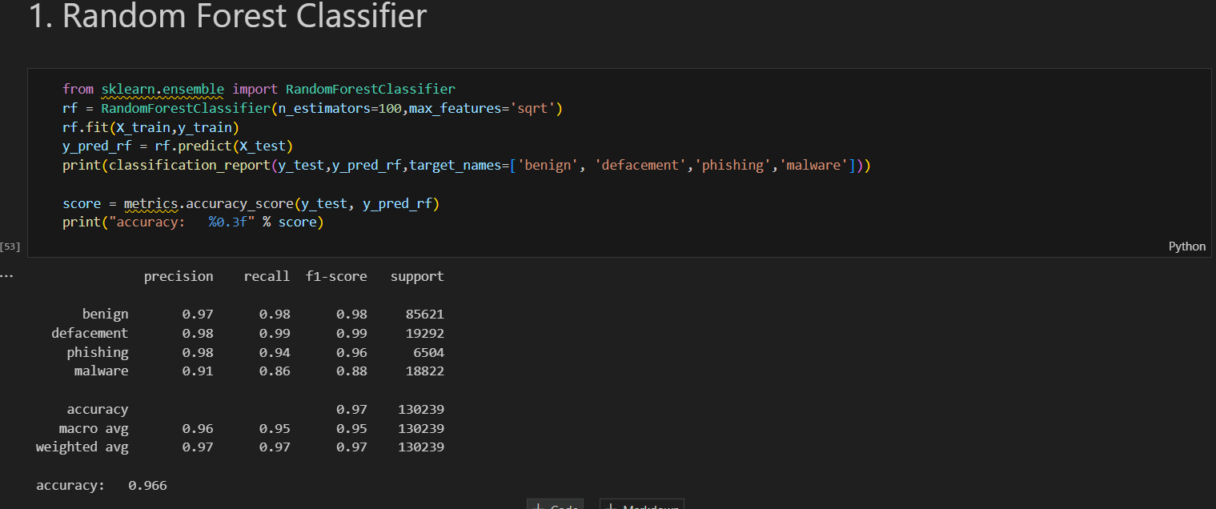
Output:

Slide 11
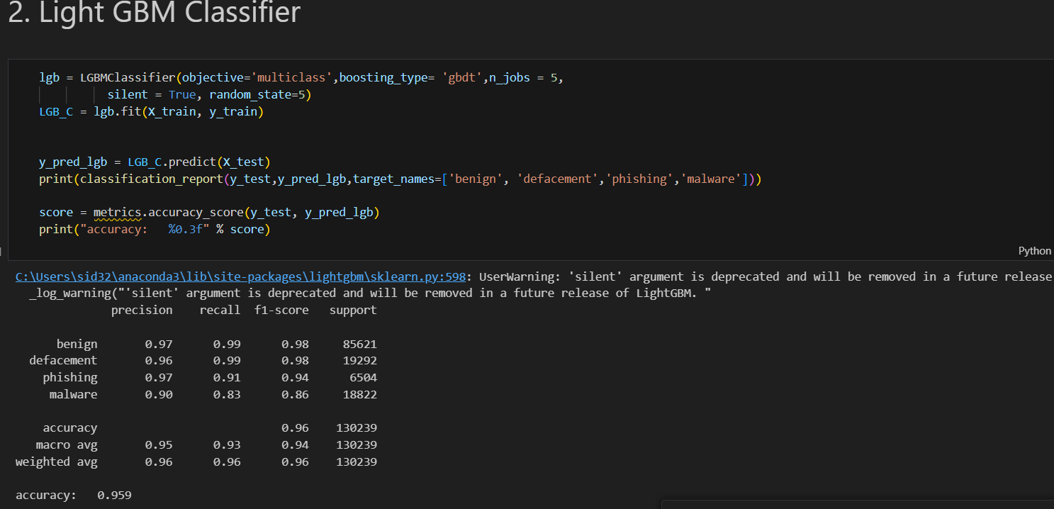

Slide 12
Thank you very much!

